Slide 1
Cloze-driven Pretraining of Self-attention Networks
Made by:
Ilya
Kachalov;
First year master degree students at NUST MISIS

Slide 2
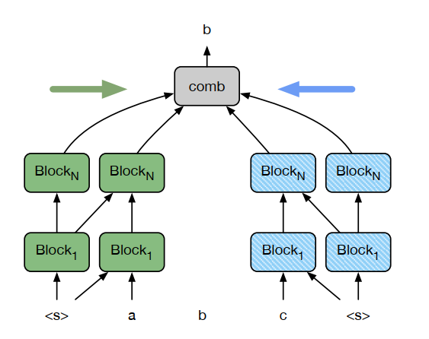
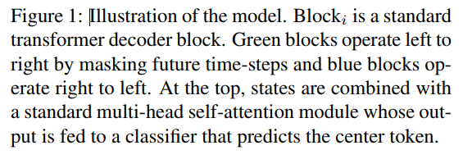

Slide 3


